Slide 1
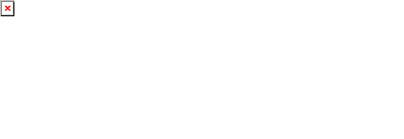
Agent Activity Detail Report
*Data provided should be considered CONFIDENTIAL and PROPRIETARY*
©2011-2023 MNX Global Logistics. All rights reserved.
6/19/2023 7:58 AM
Print User : selenium.automation

Slide 2
Agent Activity Detail Report
*Data provided should be considered CONFIDENTIAL and PROPRIETARY*
©2011-2023 MNX Global Logistics. All rights reserved.
6/19/2023 7:58 AM
Print User : selenium.automation

Slide 3
Agent Activity Detail Report
*Data provided should be considered CONFIDENTIAL and PROPRIETARY*
©2011-2023 MNX Global Logistics. All rights reserved.
6/19/2023 7:58 AM
Print User : selenium.automation

